Slide 1
Type of Event: Seminar
Topic: Career guidance
Speaker: Mr. P. Ramesh, Subject expert at ACE academy , 13th rank in M.Tech Entrance , two times gate qualified.
2 years Industrial experience
Organised by: Department of Electronics and communication
Engineering
Date: 07-11-23
Attended By: B.Tech (ECE-II YEAR, III YEAR ,IV YEAR)
Venue: Seminar Hall, A-Block
Time:
10:00 AM

Slide 3
DESCRIPTION :
The Speaker has started with introduction to the importance of ECE branch in the Engineering domain. The welcome address was given by the HOD ECE, MRCE.
Mr. P. Ramesh has explained regarding career guidance and the importance of GATE examination for Electronic engineers for about 2 hrs.
The aim and summary of the Speaker is given below:
Aim of the speaker:
Importance of ECE Branch
Significance of GATE examination
Opportunities through GATE examination( jobs and higher education)
Tips for cracking GATE examination
Summary of Presentation :
The Expert has clearly given the importance regarding career guidance and clearly explained about many opportunities through GATE and tips to achieve success in life.
The Program was ended with the Vote of thanks.
Coordinators :
1. Mrs.S. Rajeswari, Assistant Professor , ECE Dept
2. Mr.B. Nihar, Assistant Professor , ECE Dept

Slide 4
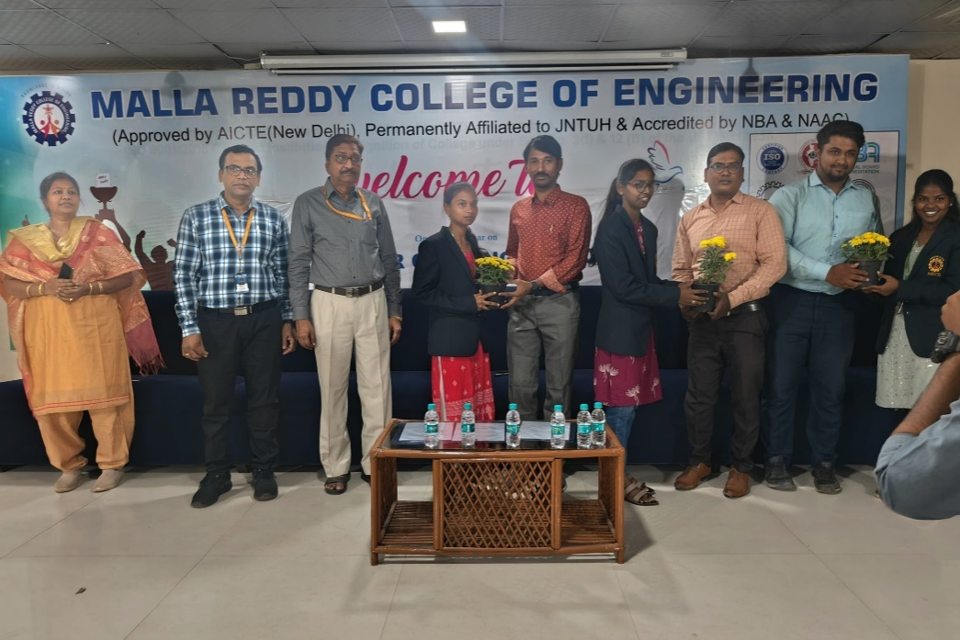
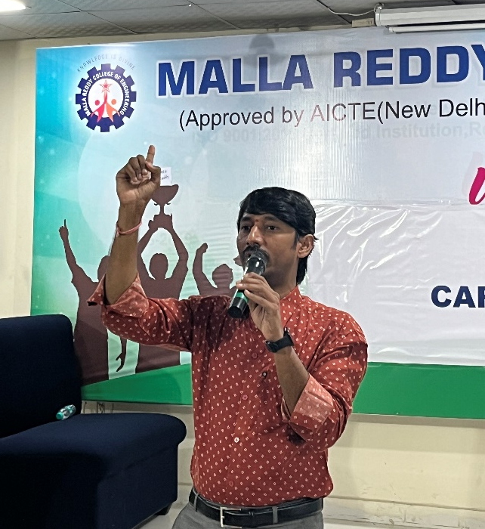
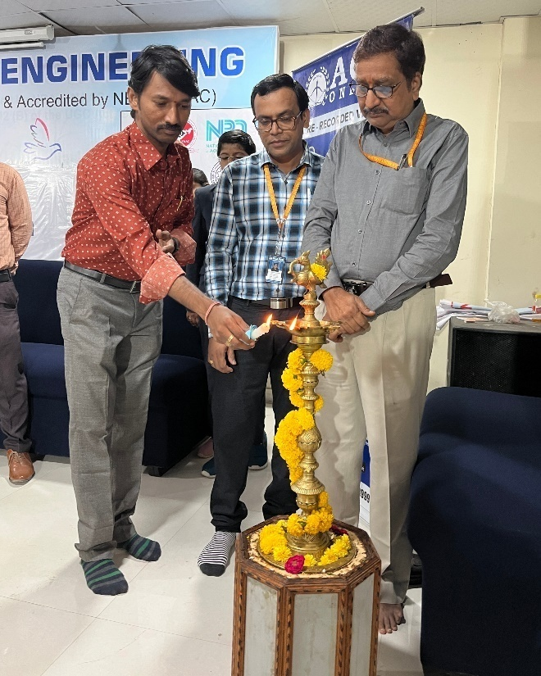
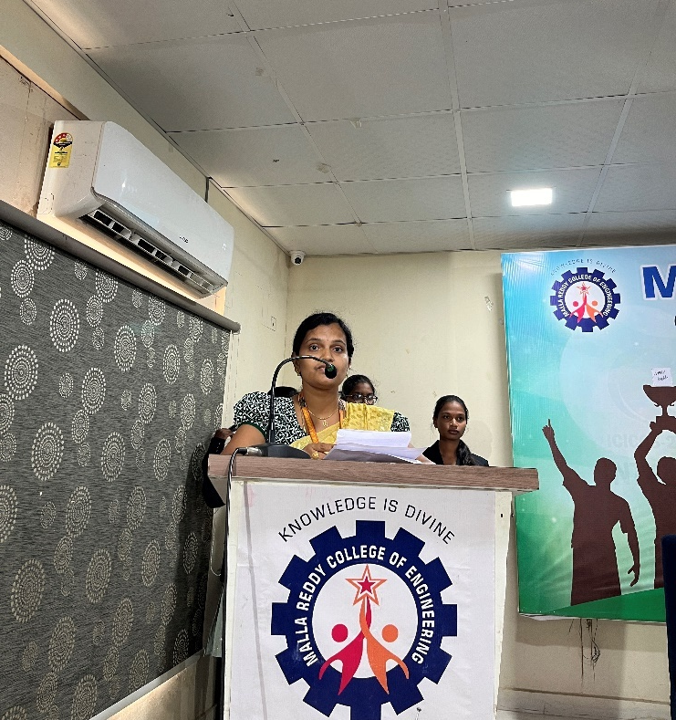

Slide 5
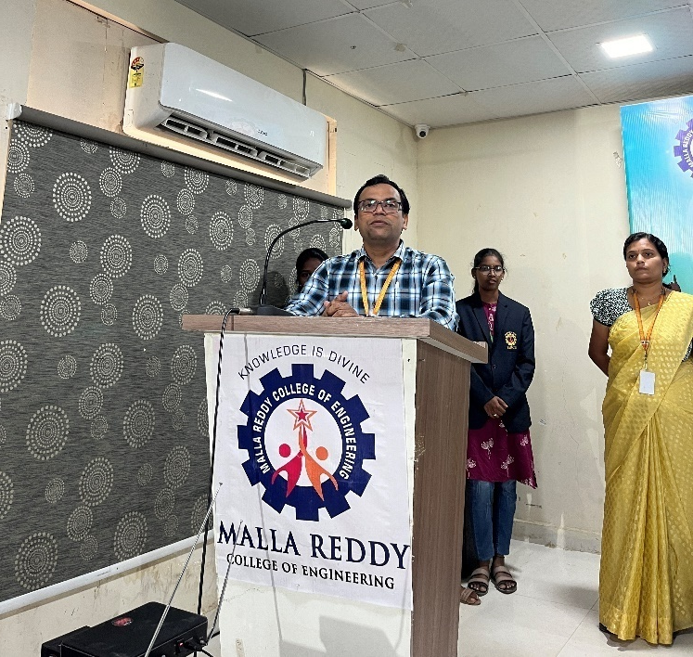
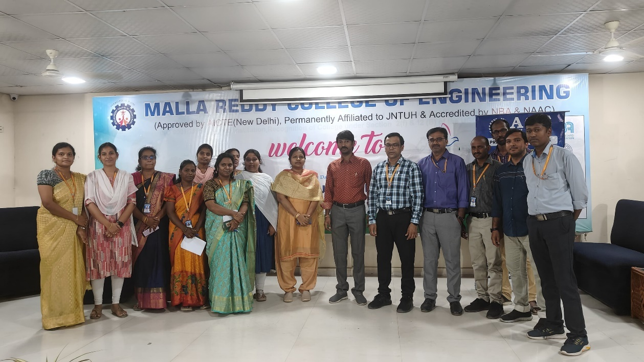
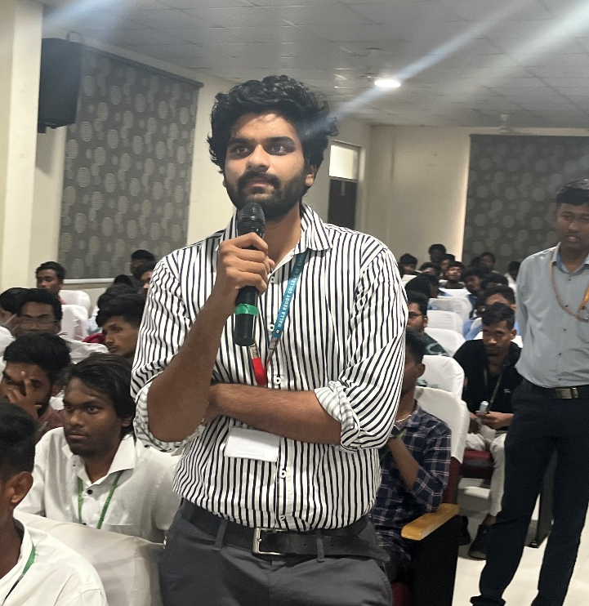
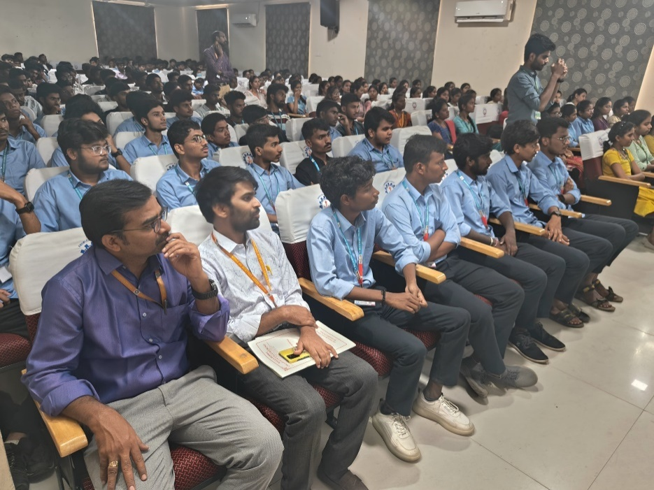

Slide 6
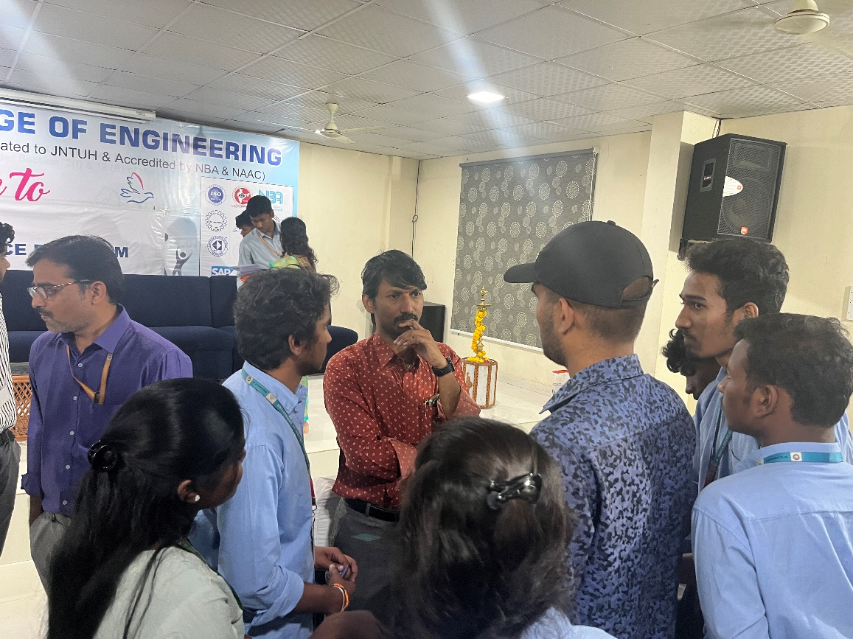
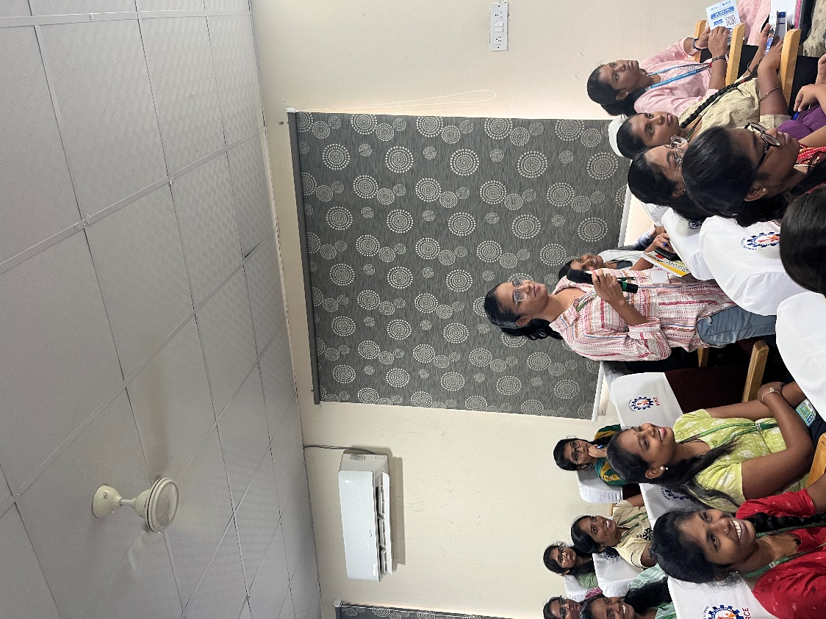

Slide 7
Thank You

